Slide 1
RECOGNISATION OF BASIC ELECTRONICS/ELECTRICAL INSTRUMENTS

Slide 2
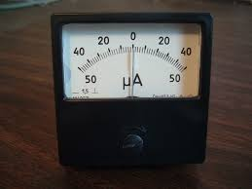
AMMETER

Slide 3
An ammeter is a measuring instrument used to measure the current in a circuit. Electric currents are measured in amperes (A), hence the name. Instruments used to measure smaller currents, in the milliampere or microampere range, are designated as milliammeters or microammeters.

Slide 4
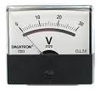
VOLTMETER

Slide 5
A voltmeter is an instrument used for measuring electrical potential difference between two points in an electric circuit. Analog voltmeters move a pointer across a scale in proportion to the voltage of the circuit; digital voltmeters give a numerical display of voltage by use of an analog to digital converter. The voltmeter in a circuit is represented by encircled 'V'.

Slide 6
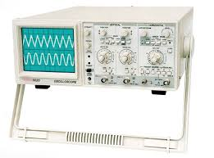
CRO (CATHODE RAY OSCILLOSCOPE)

Slide 7
An oscilloscope, previously called an oscillography and informally known as a scope, CRO (for cathode-ray oscilloscope), or DSO (for the more modern digital storage oscilloscope), is a type of electronic test instrument that allows observation of constantly varying signal voltages, usually as a two-dimensional plot of one or more signals as a function of time. Other signals (such as sound or vibration) can be converted to voltages and displayed.

Slide 8
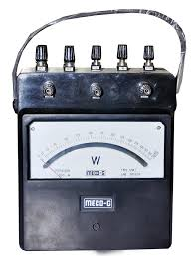
WATTMETER

Slide 9
The wattmeter is an instrument for measuring the electric power (or the supply rate of electrical energy) in watts of any given circuit. Electromagnetic wattmeters are used for measurement of utility frequency and audio frequency power; other types are required for radio frequency measurements.

Slide 10
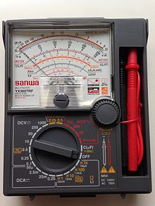
MULTIMETER

Slide 11
A multimeter or a multitester, also known as a VOM (Volt-Ohm meter or Volt-Ohm-milliammeter ), is an electronic measuring instrument that combines several measurement functions in one unit. A typical multimeter can measure voltage, current, and resistance. Analog multimeters use a microammeter with a moving pointer to display readings. Digital multimeters (DMM, DVOM) have a numeric display, and may also show a graphical bar representing the measured value. Digital multimeters are now far more common but analog multimeters are still preferable in some cases, for example when monitoring a rapidly varying value.

Slide 12
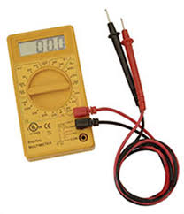
A multimeter is a combination of a multirange DC voltmeter, multirange AC voltmeter, multirange ammeter, and multirange ohmmeter. An un-amplified analog multimeter combines a meter movement, range resistors and switches.

Slide 13
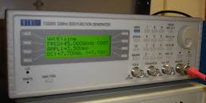
FUNCTION GENERATOR

Slide 14
A function generator is usually a piece of electronic test equipment or software used to generate different types of electrical waveforms over a wide range of frequencies. Some of the most common waveforms produced by the function generator are the sine, square, triangular and sawtooth shapes.

Slide 15
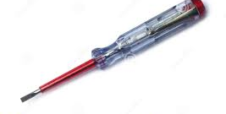
TESTER

Slide 16
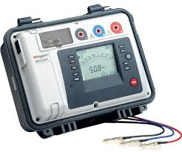
MEGGER

Slide 17
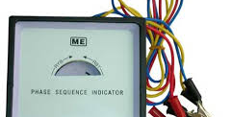
PHASE SEQUENCE INDICATOR

Slide 18
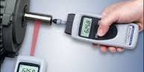
TACHOMETER

Slide 19
A tachometer (revolution-counter, tach, rev-counter, RPM gauge) is an instrument measuring the rotation speed of a shaft or disk, as in a motor or other machine.^{[1]} The device usually displays the revolutions per minute (RPM) on a calibrated analogue dial, but digital displays are increasingly common. The word comes from Greek ταχος (tachos "speed") and metron ("measure").

Slide 20

ENERGY METER

Slide 21
Watt hour meter or energy meter is an instrument which measures amount of electrical energy used by the consumers. Utilities install these instruments at every place like homes, industries, organizations to charge the electricity consumption by loads such as lights, fans and other appliances. Most interesting type are used as prepaid electricity meters.

Slide 22
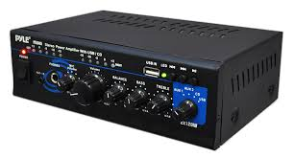
AMPLIFIER

Slide 23
An amplifier, electronic amplifier or (informally) amp is an electronic device that can increase the power of a signal.
It does this by taking energy from a power supply and controlling the output to match the input signal shape but with a larger amplitude. In this sense, an amplifier modulates the output of the power supply to make the output signal stronger than the input signal. An amplifier is effectively the opposite of an attenuator: while an amplifier provides gain, an attenuator provides loss.

Slide 24
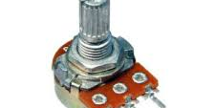
POTENTIOMETER

Slide 25
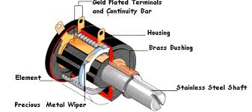
A potentiometer, informally a pot, is a three-terminal resistor with a sliding or rotating contact that forms an adjustable voltage divider. If only two terminals are used, one end and the wiper, it acts as a variable resistor or rheostat.

Slide 26
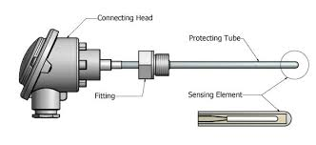
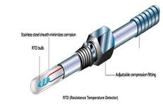
RTD (RESISTANCE TEMPERATURE DETECTORS)
OR RESISTANCE THERMOMETERS

Slide 27
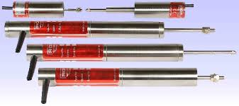
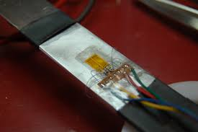
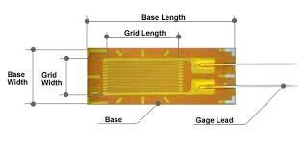
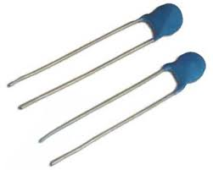
LVDT
STRAIN GAUGE
THERMISTORS

Slide 28


